Slide 1



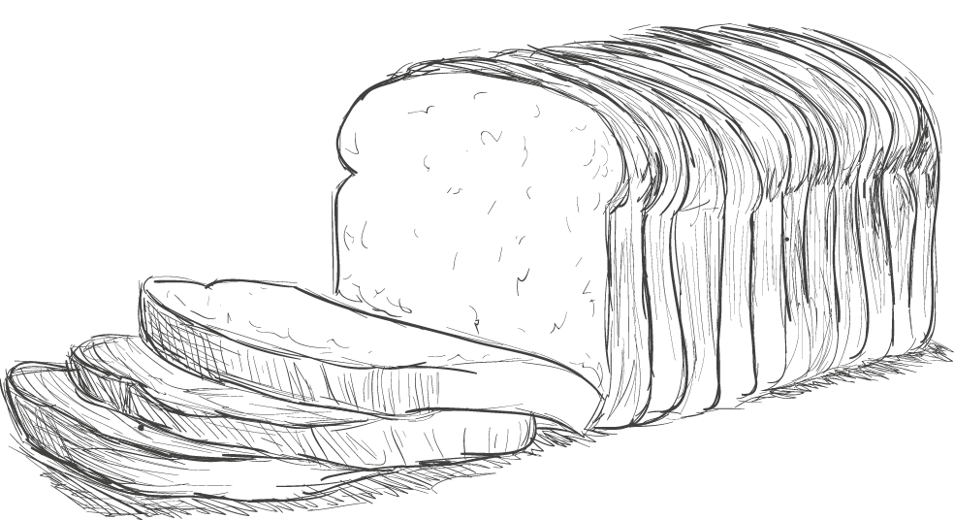
从前慢
文艺简约PPT商务通用模板

Slide 2

单击此处输入标题
Click here to enter a title
单击此处输入标题
Click here to enter a title
单击此处输入标题
Click here to enter a title
单击此处输入标题
Click here to enter a title
目 录
Contents

Slide 3

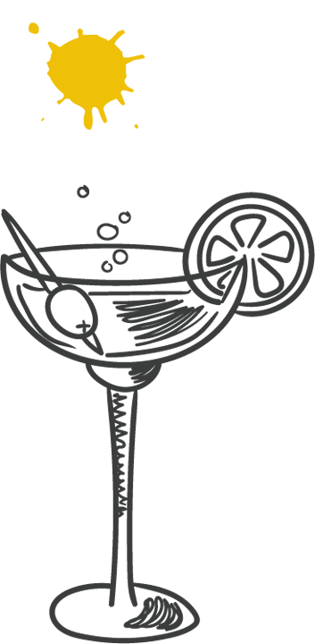
Part.01
单击此处输入标题
Click here to enter a title

Slide 4

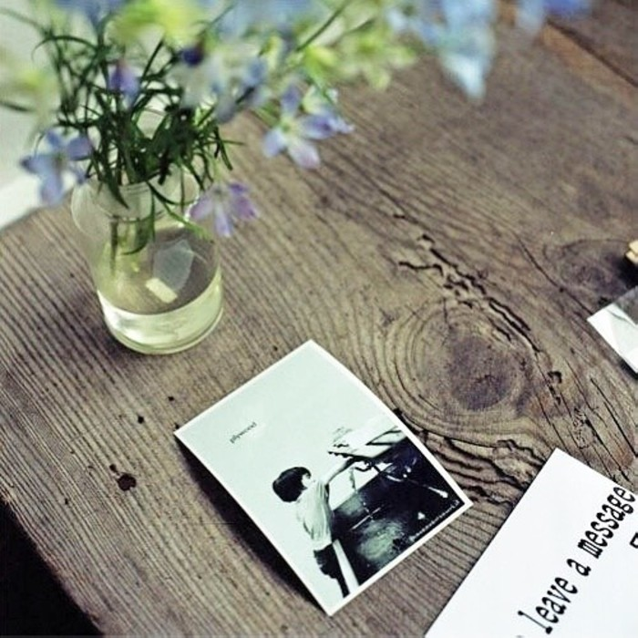
单击此处输入标题文本
KNOWLEDGE IS POWER
KNOWLEDGE IS POWER
No matter how bad your heart has been broken, the world doesn’t stop for your grief. The sun comes right back up the next day.
No matter how bad your heart has been broken, the world doesn’t stop for your grief. The sun comes right back up the next day.
No matter how bad your heart has been broken, the world doesn’t stop for your grief. The sun comes right back up the next day.
No matter how bad your heart has been broken, the world doesn’t stop for your grief. The sun comes right back up the next day.

Slide 5
单击此处输入标题文本
单击此处输入标题
单击此处输入标题
单击此处输入标题
单击此处输入标题
If they throw stones at you, don’t throw back, use them to build your own foundation instead.
If they throw stones at you, don’t throw back, use them to build your own foundation instead.
If they throw stones at you, don’t throw back, use them to build your own foundation instead.
If they throw stones at you, don’t throw back, use them to build your own foundation instead.
单击此处输入标题
单击此处输入标题
单击此处输入标题
单击此处输入标题
If they throw stones at you, don’t throw back, use them to build your own foundation instead.
If they throw stones at you, don’t throw back, use them to build your own foundation instead.
If they throw stones at you, don’t throw back, use them to build your own foundation instead.
If they throw stones at you, don’t throw back, use them to build your own foundation instead.

Slide 6

单击此处输入标题文本
单击此处输入标题文本
No matter how bad your heart has been broken, the world doesn’t stop for your grief. The sun comes right back up the next day.
No matter how bad your heart has been broken, the world doesn’t stop for your grief. The sun comes right back up the next day.
单击此处输入文本
单击此处输入文本

Slide 7
单击此处输入标题文本
Love is not a maybe thing. You know when you love someone.
Love is not a maybe thing. You know when you love someone.
输入文本
Love is not a maybe thing. You know when you love someone.
Love is not a maybe thing. You know when you love someone.
Love is not a maybe thing. You know when you love someone.

Slide 8
Part.02
单击此处输入标题
Click here to enter a title

Slide 9
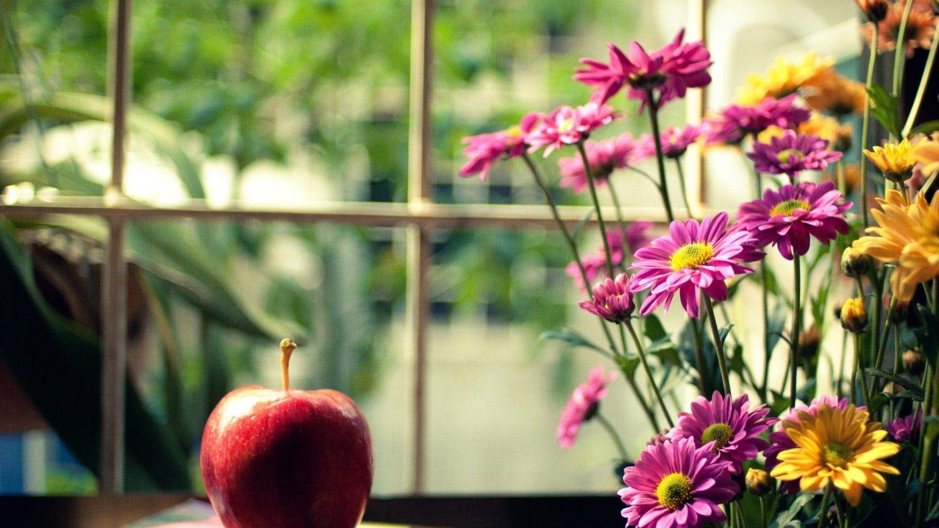
单击此处输入标题文本
No matter how bad your heart has been broken, the world doesn’t stop for your grief. The sun comes right back up the next day.
No matter how bad your heart has been broken, the world doesn’t stop for your grief. The sun comes right back up the next day.
单击此处输入标题
单击此处输入标题
No matter how bad your heart has been broken, the world doesn’t stop for your grief. The sun comes right back up the next day.
No matter how bad your heart has been broken, the world doesn’t stop for your grief. The sun comes right back up the next day.

Slide 10
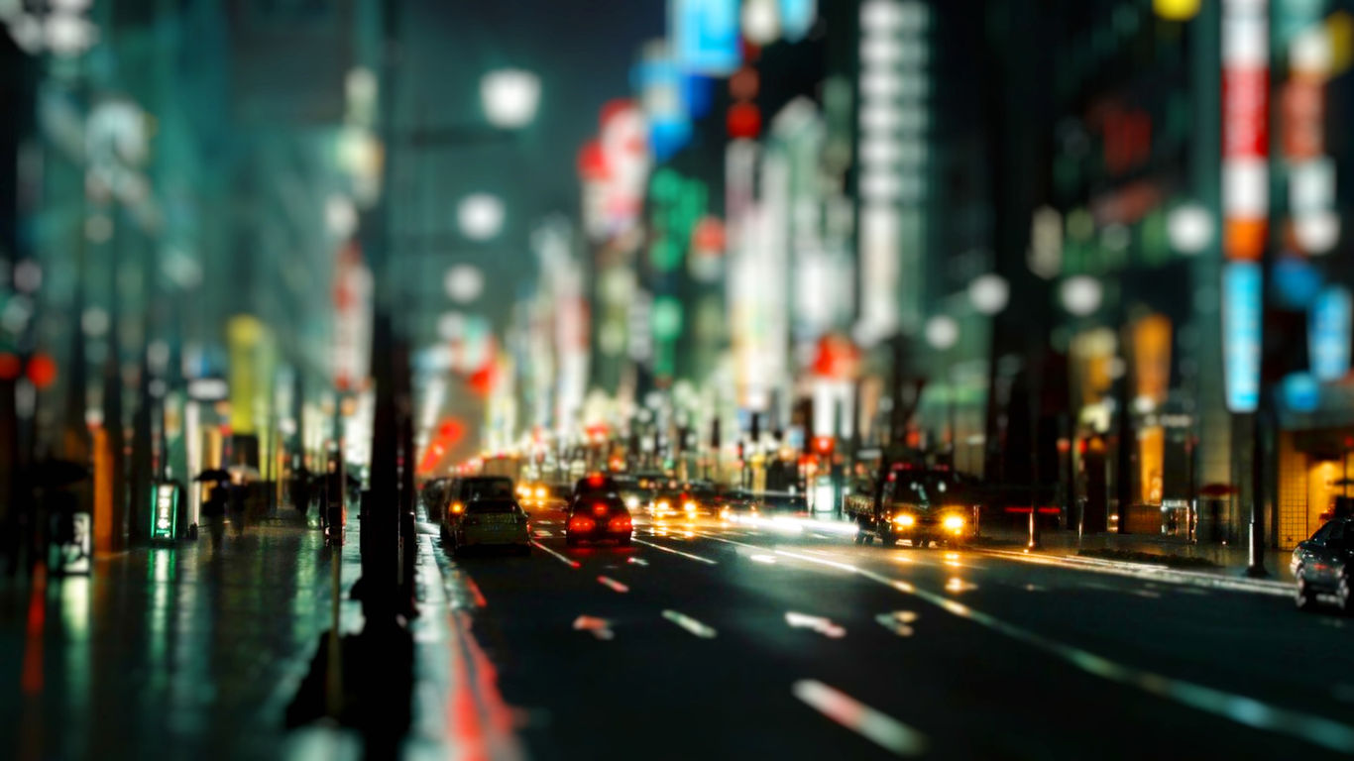
单击此处输入标题文本
单击此处输入标题
If they throw stones at you, don’t throw back, use them to build your own foundation instead.
单击此处输入标题
If they throw stones at you, don’t throw back, use them to build your own foundation instead.
单击此处输入标题
If they throw stones at you, don’t throw back, use them to build your own foundation instead.

Slide 11


单击此处输入标题文本
KNOWLEDGE IS POWER
No matter how bad your heart has been broken, the world doesn’t stop for your grief. The sun comes right back up the next day.
No matter how bad your heart has been broken, the world doesn’t stop for your grief. The sun comes right back up the next day.

Slide 12
单击此处输入标题文本
No matter how bad your heart has been broken, the world doesn’t stop for your grief. The sun comes right back up the next day.
No matter how bad your heart has been broken, the world doesn’t stop for your grief. The sun comes right back up the next day.
单击此处输入文本
No matter how bad your heart has been broken, the world doesn’t stop for your grief. The sun comes right back up the next day.
No matter how bad your heart has been broken, the world doesn’t stop for your grief. The sun comes right back up the next day.

Slide 13
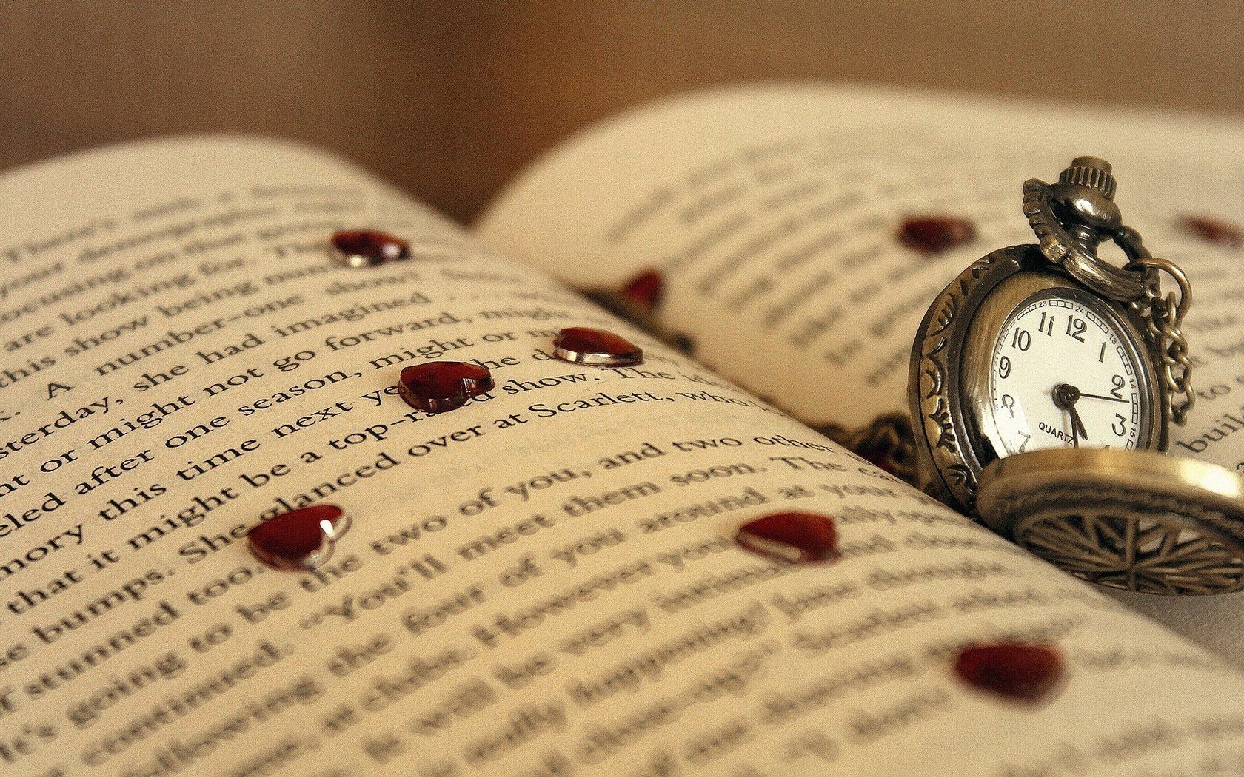
单击此处输入标题文本
单击此处输入标题
If they throw stones at you, don’t throw back, use them to build your own foundation instead.
If they throw stones at you, don’t throw back, use them to build your own foundation instead.
单击此处输入标题
If they throw stones at you, don’t throw back, use them to build your own foundation instead.
If they throw stones at you, don’t throw back, use them to build your own foundation instead.

Slide 14
Part.03
单击此处输入标题
Click here to enter a title

Slide 15



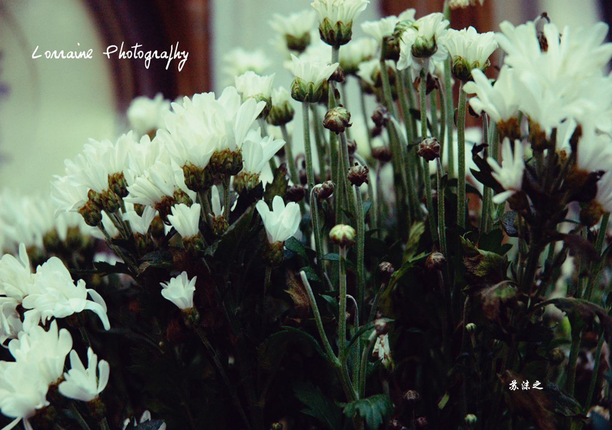
单击此处输入标题文本
单击此处输入标题
单击此处输入标题
单击此处输入标题
单击此处输入标题
No matter how bad your heart has been broken, the world doesn’t stop for your grief. The sun comes right back up the next day.No matter how bad your heart has been broken, the world doesn’t stop for your grief. The sun comes right back up the next day.No matter how bad your heart has been broken, the world doesn’t stop for your grief. The sun comes right back up the next day.

Slide 16
单击此处输入标题文本
单击此处输入标题
输入文本
If they throw stones at you, don’t throw back, use them to build your own foundation instead.
If they throw stones at you, don’t throw back, use them to build your own foundation instead.
单击此处输入标题
If they throw stones at you, don’t throw back, use them to build your own foundation instead.
If they throw stones at you, don’t throw back, use them to build your own foundation instead.
输入文本
输入文本

Slide 17

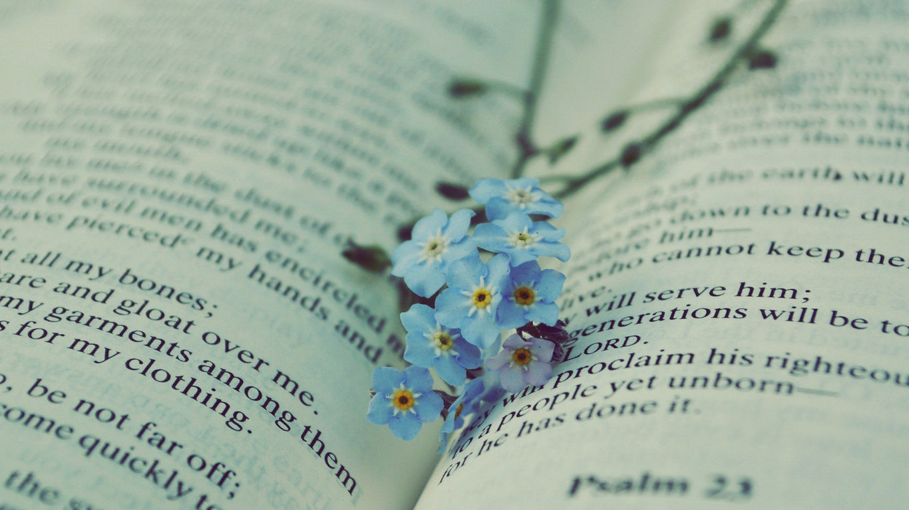
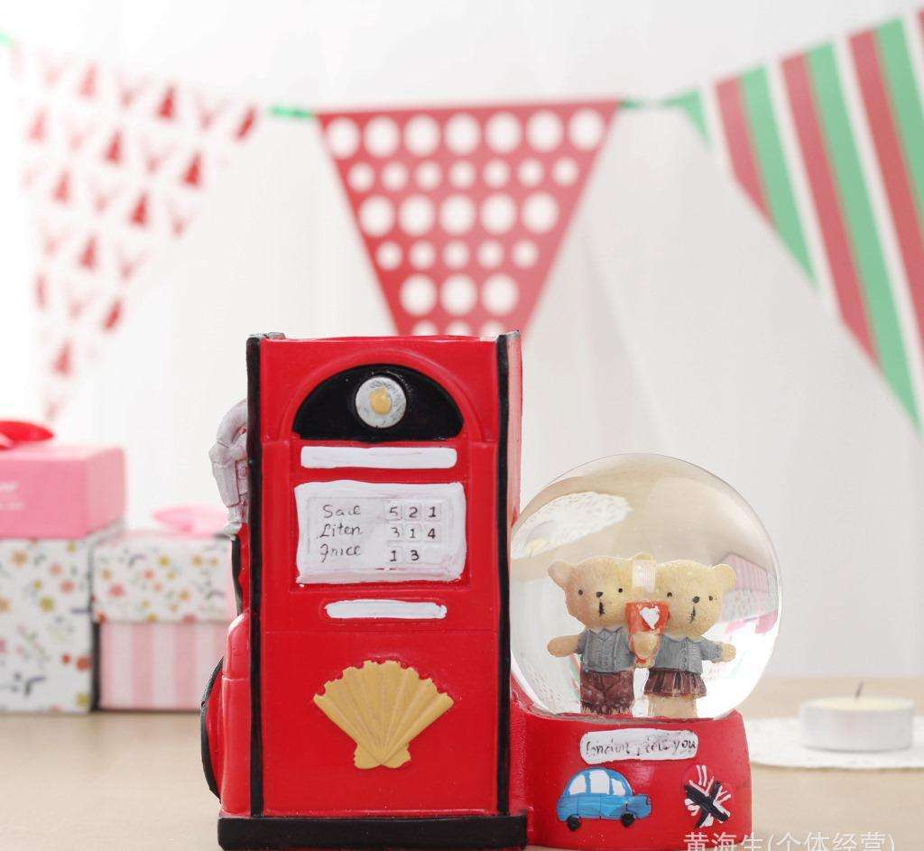
单击此处输入标题文本
If they throw stones at you, don’t throw back, use them to build your own foundation instead.
If they throw stones at you, don’t throw back, use them to build your own foundation instead.

Slide 18
单击此处输入标题文本
单击此处输入文本
单击此处输入文本
No matter how bad your heart has been broken, the world doesn’t stop for your grief. The sun comes right back up the next day.
02
No matter how bad your heart has been broken, the world doesn’t stop for your grief. The sun comes right back up the next day.
01
单击此处输入文本
单击此处输入文本
No matter how bad your heart has been broken, the world doesn’t stop for your grief. The sun comes right back up the next day.
No matter how bad your heart has been broken, the world doesn’t stop for your grief. The sun comes right back up the next day.
04
03

Slide 19
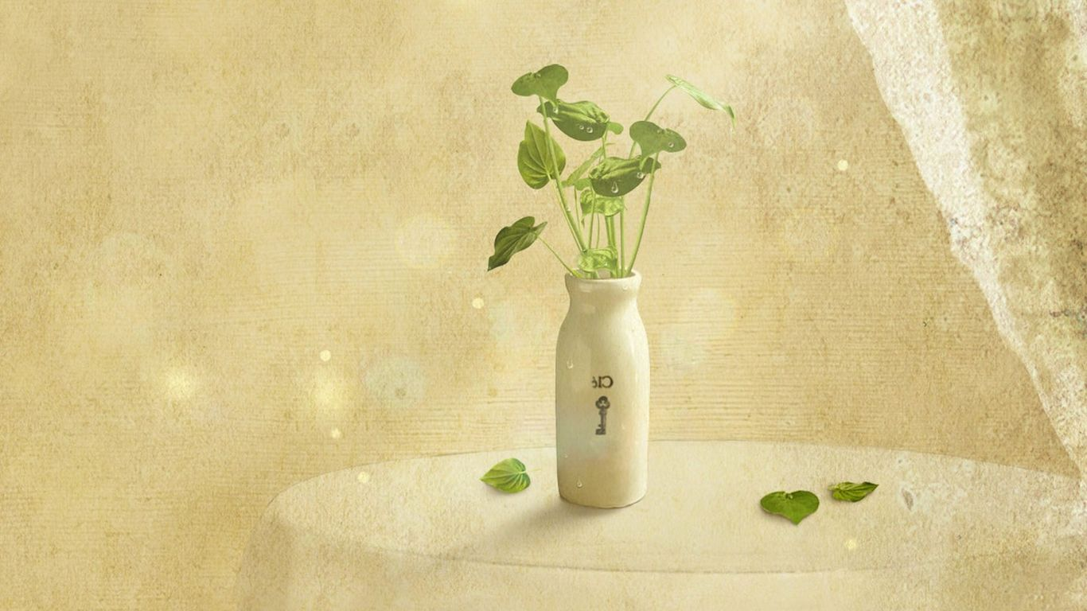
单击此处输入标题文本
No matter how bad your heart has been broken, the world doesn’t stop for your grief. The sun comes right back up the next day.No matter how bad your heart has been broken, the world doesn’t stop for your grief. The sun comes right back up the next day.No matter how bad your heart has been broken, the world doesn’t stop for your grief. The sun comes right back up the next day.

Slide 20
Part.04
单击此处输入标题
Click here to enter a title

Slide 21
单击此处输入标题文本
单击此处输入文本
No matter how bad your heart has been broken, the world doesn’t stop for your grief. The sun comes right back up the next day.
No matter how bad your heart has been broken, the world doesn’t stop for your grief. The sun comes right back up the next day.
单击此处输入文本
No matter how bad your heart has been broken, the world doesn’t stop for your grief. The sun comes right back up the next day.
No matter how bad your heart has been broken, the world doesn’t stop for your grief. The sun comes right back up the next day.

Slide 22
单击此处输入标题文本
单击此处输入文本
单击此处输入文本
No matter how bad your heart has been broken, the world doesn’t stop for your grief. The sun comes right back up the next day.
No matter how bad your heart has been broken, the world doesn’t stop for your grief. The sun comes right back up the next day.
单击此处输入文本
单击此处输入文本
No matter how bad your heart has been broken, the world doesn’t stop for your grief. The sun comes right back up the next day.
No matter how bad your heart has been broken, the world doesn’t stop for your grief. The sun comes right back up the next day.

Slide 23

单击此处输入标题文本
KNOWLEDGE IS POWER
No matter how bad your heart has been broken, the world doesn’t stop for your grief. The sun comes right back up the next day.
No matter how bad your heart has been broken, the world doesn’t stop for your grief. The sun comes right back up the next day.
KNOWLEDGE IS POWER
No matter how bad your heart has been broken, the world doesn’t stop for your grief. The sun comes right back up the next day.

Slide 24

单击此处输入标题文本
KNOWLEDGE IS POWER
KNOWLEDGE IS POWER
No matter how bad your heart has been broken, the world doesn’t stop for your grief. The sun comes right back up the next day.
No matter how bad your heart has been broken, the world doesn’t stop for your grief. The sun comes right back up the next day.
No matter how bad your heart has been broken, the world doesn’t stop for your grief. The sun comes right back up the next day.
No matter how bad your heart has been broken, the world doesn’t stop for your grief. The sun comes right back up the next day.

Slide 25
谢谢观看
Thank you for watching

